Slide 1
ET0023 Operating Systems
10. Disk Storage

Slide 2
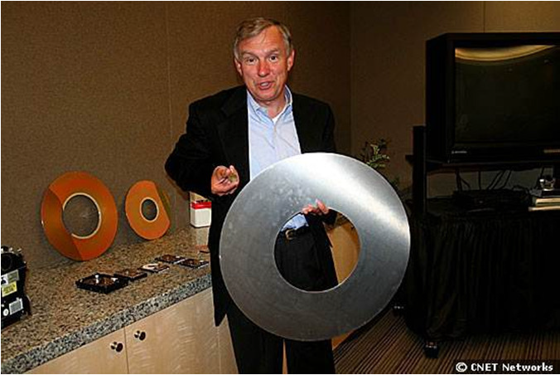
Size Matters
Bill Healy, executive vice president at Hitachi, holds up a platter from a 1-inch microdrive in his
right hand. In his left is a 24-inch platter from IBM's RAMAC (Random Access Method of
Accounting and Control), which came out 50 years ago. A 1-inch 8GB platter holds more than
80,000 times as much data as a single 24-inch RAMAC platter. An 8GB 1-inch drive holds 1,600
times as much data as RAMAC.
Credit: Michael Kanellos, CNET News.com (http://asia.cnet.com/hard-drive-hits-the-big-five-zero-39434750.htm)

Slide 3
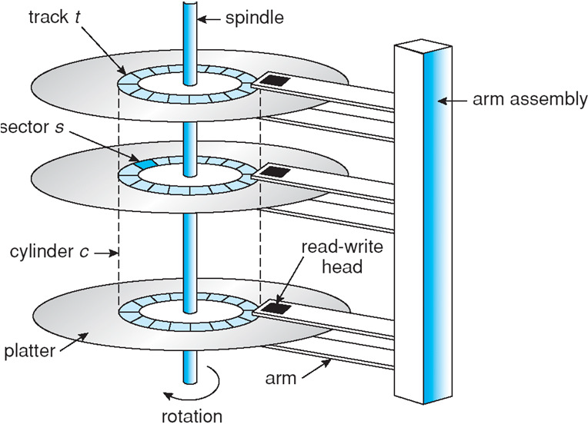
Internal Structure

Slide 4
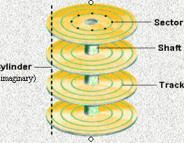
Sectors and tracks
Data is stored on the surface of a platter in sectors along the tracks.
Tracks are concentric circles on the disk.
And sectors are part portion of a track.

Slide 5
Magnetic Storage Terms
A disk consists of one or more metal/glass platters which may be accessed on 1 or 2 surfaces.
Each platter is divided into a number of concentric tracks.
A cylinder is made up of a track on each of the platters at the same horizontal position.
Each track is divided into sectors which usually hold 512 bytes of user data.
Outside tracks (OD)may hold more information than inside tracks (ID) on a platter.
The platters spin at a high speed measured in RPM.
Seek time is the time taken for the Read/Write head to move from one track to another for information.
The amount of data that the drive can read/write per second is known as the data access rate.
Notes:
How many sectors are there in 1 Mega byte of user data?
No. of sector = 1024000 / 512 = 1000 K / 0.5 K = 2000 sectors

Slide 6
Overheads
To read from disk, we must specify:
cylinder #, surface #, sector #, transfer size, memory address
CHS and LBA scheme
Transfer time: get bits off the disk to computer
Transfer time includes:
Seek time: to get to the track
Latency time: to get to the sector
Track
Sector
Seek Time
Rotation
Delay
Notes:
What is the time of one revolution of the disk for 7200 RPM drive?
No. of rev per second = 7200 / 60 = 120
time per rev = 1000 /120 ms = 8.33 ms

Slide 7
Access time
Access time = Seek time + Latency time + Overheads
What is the time of one revolution of the disk for 7200 RPM drive?
No. of rev per second = 7200 / 60 = 120
time per rev = 1000 /120 ms = 8.33 ms
Latency time = ½ of rev time = 4.17 ms
Access time = 7 ms + 4.17 ms + 0.5 ms =~ 12 ms

Slide 8
Modern Disk Drives
 | Seagate Barracuda 7200.12 | Seagate Cheetah 15K7
Capacity | 1 TB | 300 GB
Disk/Heads | 1/2 | 2/4
Cache | 32 MB | 16 MB
Speed | 7200RPM | 15000RPM
Latency (ms) | 4.16 | 2.0
Avg seek (ms) | 8.5/9.5 | 3.4/3.9
Avg data rate (MB/s) | 156 | 600
Interface | SATA 3GB/s | 6 GB/s SAS

Slide 9
Disk Structure
Disk drives addressed as 1-dim arrays of logical blocks (the smallest unit of transfer)
This array mapped sequentially onto disk sectors
Address 0 is 1st sector of 1st track of the outermost cylinder
Addresses incremented within track, then within tracks of the cylinder, then across cylinders, from innermost to outermost
Translation is theoretically possible, but usually difficult
Some sectors might be defective
Number of sectors per track is not a constant

Slide 10
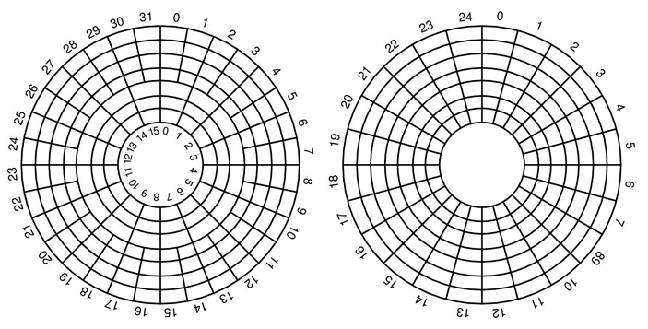
Disk Sectors / Track
Reduce bit density per track for outer layers (Constant
Linear Velocity, typically HDDs)
• Have more sectors per track on the outer layers, and
increase rotational speed when reading from outer
tracks (Constant Angular Velocity, typically CDs, DVDs)

Slide 11
Disk Scheduling
The operating system tries to use hardware efficiently
for disk drives having fast access time, disk bandwidth
Access time has two major components
Seek time is time to move the heads to the cylinder containing the desired sector
Rotational latency is additional time waiting to rotate the desired sector to the disk head.
Task: Minimize seek time
Seek time » seek distance
Disk bandwidth is total number of bytes transferred, divided by the total time between the first request for service and the completion of the last transfer.
Different algorithms exist for addressing this problem.

Slide 12
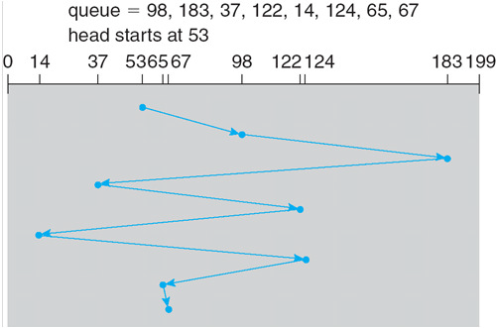
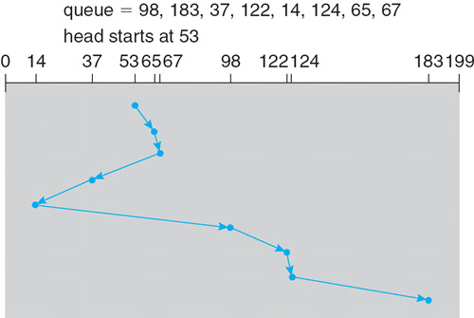
Disk Scheduling Algorithms
First-Come-First-Served
Shortest-Seek-Time-First
SCAN | starts at one end of disk, moves to the other end, servicing requests, reverses repeating action
C-SCAN | starts at one end of disk, moves to the other end, servicing requests, returns to start position
C-LOOK | Actuator arm only goes as far as last request in each direction, then reverses

Slide 13
Good Algorithms
Performance depends on number and types of requests
Requests for disk service can be influenced by the file allocation method.
Disk-scheduling algorithm should be a separate OS module (replacement is possible)
Choices:
SSTF is common and has a natural appeal
SCAN and C-SCAN perform better under heavy load
Either SSTF or LOOK is a reasonable default algorithm

Slide 14
Low-level Disk Formatting
After manufacturing disk has no information
Is stack of platters coated with magnetizable metal oxide
Before use, each platter receives low-level format
Format has series of concentric tracks
Each track contains some sectors
There is a short gap between sectors
Preamble allows h/w to recognize start of sector
Also contains cylinder and sector numbers
Data is usually 512 bytes
Error Correction Code (ECC) field used to detect and recover from read errors
Preamble | Data | ECC

Slide 15
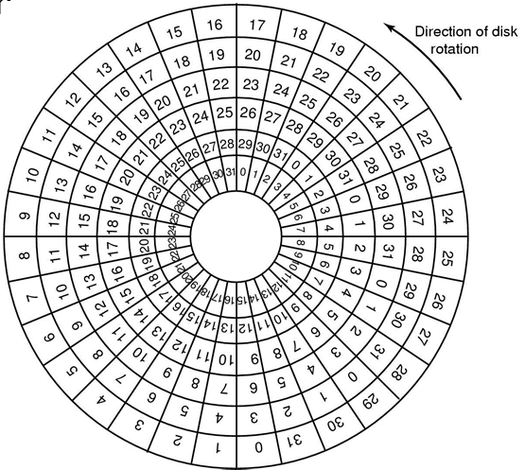
Cylinder Skew
Rotation speed: 10000 rpm
Drive rotates in 6 ms
Track has 300 sectors
New sector every 20 μs
If track seek time 800 μs
40 sectors pass on seek
Cylinder skew: 40 sectors

Slide 16
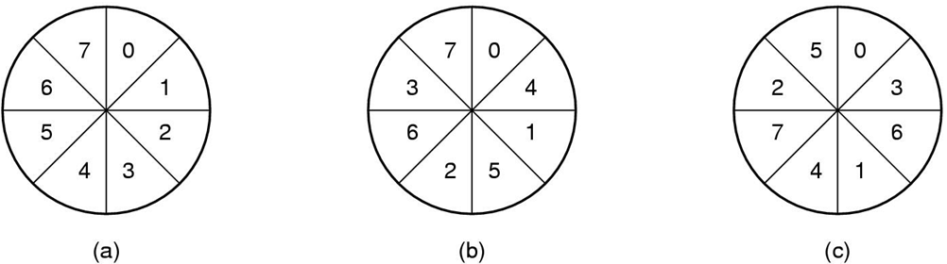
Formatting & Performance
If 10K rpm, 300 sectors of 512 bytes per track
153600 bytes every 6 ms 24.4 MB/sec transfer rate
If disk controller buffer can store only one sector
For 2 consecutive reads, 2nd sector flies past during memory transfer of 1st track
Idea: Use single/double interleaving

Slide 17
Disk Partitioning
Each partition is like a separate disk
Sector 0 is MBR
contains boot code + partition table
Partition table has starting sector and size of each partition
High-level formatting
Done for each partition
Specifies boot block, free list, root directory, empty file system
What happens on boot?
BIOS loads MBR, boot program checks to see active partition
Reads boot sector from that partition that then loads OS kernel, etc
Modern PC OS have 4 partitions (3 primary, 1 extended)

Slide 18
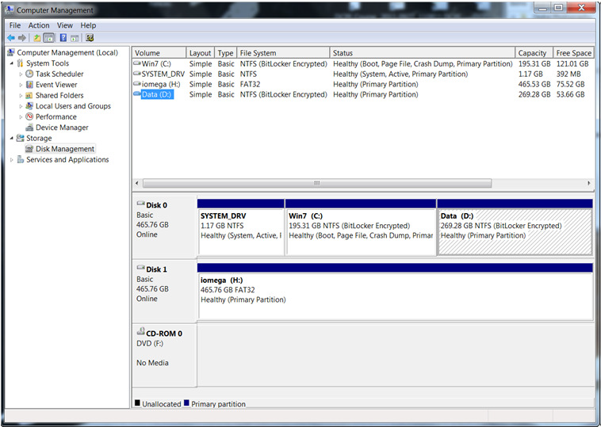
Disk Partitioning Software
Using windows Disk Management or CLI Fdisk.exe

Slide 19
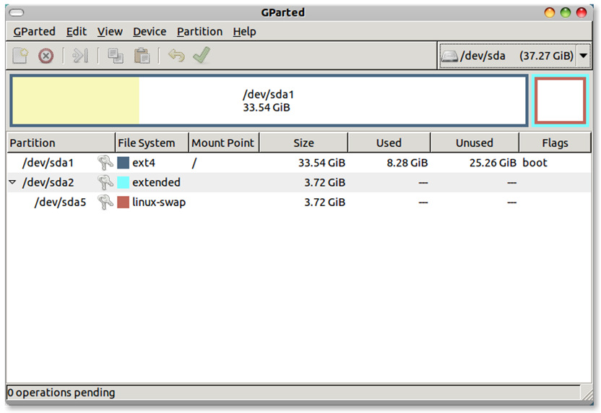
GNU GParted

Slide 20
Typical Windows Partitions
500GB Disk
100GB | 200~250GB | 100GB | 16GB
Win OS
Data
Images /
restore point
Swap
500GB Disk
100GB
200~250GB | 100GB | 16GB
Primary
Extended Logical Drives

Slide 21
Typical Linux Partitions
A Linux system consists of
root (/)
tmp for temporary files
var for files that change
usr for system files and programs
/home
User home directories
Swap
Partitions are usually created for each, though newer systems use Logical Volumes

Slide 22
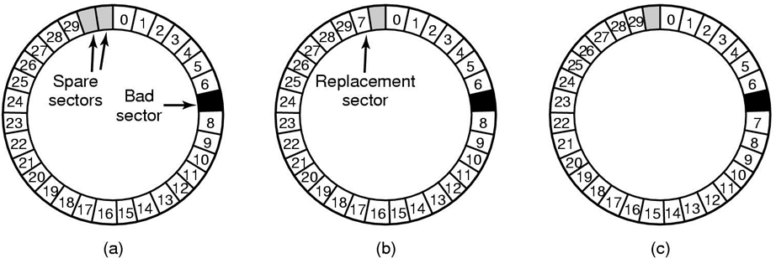
What happens if a disk is bad?
A disk track with a bad sector
Solutions:
Substitute a spare for the bad sector (sector sparing)
Shift all sectors to bypass bad one (sector forwarding

Slide 23
Speed vs Data Integrity
Disks are improving, but not as fast as CPUs
1970s seek time: 50-100 ms.
2000s seek time: <5 ms.
Factor of 20 improvement in 3 decades
We can use multiple disks for improving performance
By Striping files across multiple disks (placing parts of each file on a different disk), parallel I/O can improve access time
Striping reduces reliability
100 disks have 1/100th mean time between failures of one disk
So, we need Striping for performance, but we need something to help with reliability / availability
To improve reliability, we can add redundant data to the disks, in addition to Striping

Slide 24
Striping
Data to be written
A | B | C | D | E | F | G | H | I | J | K | L
G | H | I
Striping Disk Device
D | E | F
A | B | C
G
H
I
D
E
F
A
B
C

Slide 25
RAID
Redundant Array of Independent Disks
Motivation
Disk drives are small and cheap, can replace large disks with an array
Requires a RAID controller
Can put in striped data plus redundancy information
Alternatives:
SLED (Single Large Expensive Disk)
JBOD (Just a Bunch Of Disks)
SPAN (concatenation of disks)

Slide 26
RAID Issues
Granularity
fine-grained: Stripe each file over all disks. This gives high throughput for the file, but limits to transfer of 1 file at a time
coarse-grained: Stripe each file over only a few disks. This limits throughput for 1 file but allows more parallel file access
Redundancy
uniformly distribute redundancy info on disks: avoids load balancing problems
concentrate redundancy info on a small number of disks: partition the set into data disks and redundant disks

Slide 27
RAID 0
Level 0 is non-redundant disk array
Files are Striped across disks, no redundant info
High read throughput.
Best write throughput (no redundant info to write)
Any disk failure results in data loss
Reliability worse than SLED
G
H
I
D
E
F
A
B
C
RAID 0 – Blocks Striped, No Mirror, No Parity

Slide 28
RAID 1
Mirrored Disks
Data is written to two places
On failure, just use surviving disk
On read, choose fastest to read
Write performance is same as single drive, read performance is 2x better
Expensive
Disk
Mirror
C
C
B
B
A
A
RAID 1 – No Stripe, Mirror, No Parity

Slide 29
RAID 5
Minimum 3 disks.
Good performance (as blocks are striped).
Good redundancy (distributed parity).
Best cost effective option providing both performance and redundancy.
Use this for DB that is heavily read oriented. Write operations will be slow
E
F
P2
C
P1
D
P0
A
B
RAID 5 – Blocks Striped, No Mirror, Distributed Parity

Slide 30
Parity & Hamming Codes
Parity
Detect a single error
Cannot tell you which of the bits is in error
Hamming codes
Detect double bit errors
Detect & correct single bit errors
Detection and correction require more work
Error Correcting Codes
Introduce redundancy into data
Able to detect and correct N errors

Slide 31
RAID 6
Block level striping with double distributed parity.
Can tolerate 2 hard disk failures
Faster than RAID 5 on read
Slower on writes
Essential in today's large capacity drives

Slide 32
What about RAID 2,3,4 ?
RAID 2
bit level striping with ECC codes for error correction.
Requires many disks (data + ECC).
Complicated
RAID 3
Uses a parity disk (holds parity of corresponding bits on other drives)
Read accesses all data disks
Write accesses all data disks and parity
Use parity disk to compute missing data
RAID 4
Combines RAID 0 and 3
Block level parity with striping
Heavy load on the parity disk
Theoretical,
Not used

Slide 33
RAID 0 + 1
Uses 2 disk arrays
Array 1 runs in RAID 0
Data is block-striped across this array
Array 2 is a mirror of Array 1
DATA
G
H
I
D
E
F
A
B
C
G
H
I
D
E
F
A
B
C

Slide 34
RAID 1 + 0 (10)
Uses 2 disk arrays
Array 1 and 2 runs in RAID 0
Each drive in Array 1 is mirrored to Array 2
On a drive failure, only faulty drive is replaced
DATA
G
H
I
D
E
F
A
B
C
G
H
I
D
E
F
A
B
C

Slide 35
RAID Controllers
Hardware RAID
Most common method of implementing Industry-standard RAID
hardware controllers e.g. Adaptec, Intel
Advantages
Dedicated hardware for striping, parity
Data caching
Improved speeds on read/write
Software RAID
MS Windows built into Disk Management
Linux: mdadm utility
Advantages
Common platform, not hardware dependent
Cheap
Modern day CPUs are fast enough to handle processing

Slide 36
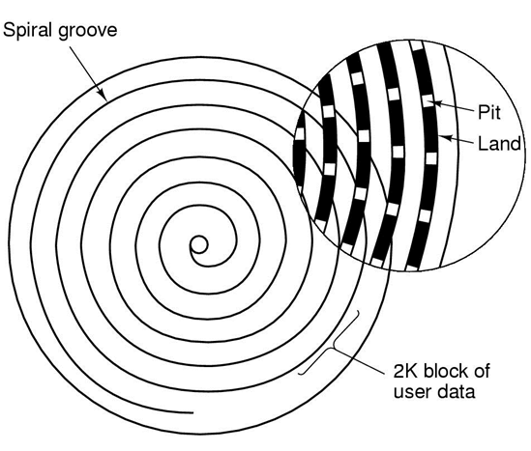
CD-ROM
Spiral makes 22,188 revolutions around disk (approx 600/mm).
Will be 5.6 km long. Rotation rate: 530 rpm to 200 rpm

Slide 37
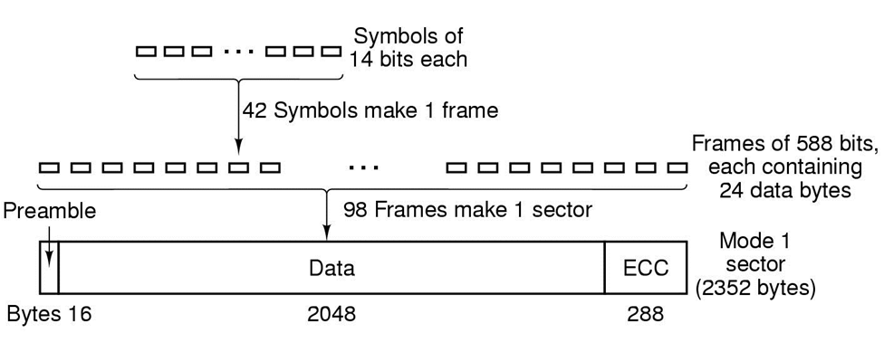
CD-ROM Layout
Logical data layout on a CD-ROM

Slide 38
QUESTIONS

Slide 39
Head Disk Coupling Field
g=gap size d=flying height δ=magnetic layer thickness v=surface velocity
Magnetic flux
g
Head gap fringing field
d
δ
v

Slide 40
Perpendicular Magnetic Recording
Electrically Conductive Coil
Perpendicular Recording Head
Recording Medium
“Soft” Magnetic Layer
Direction of Medium Travel
Magnetic Head reflection

Slide 41
Areal Density
Magnetic pattern written on disk media
Current areal density, tpi, bpi?

Slide 42
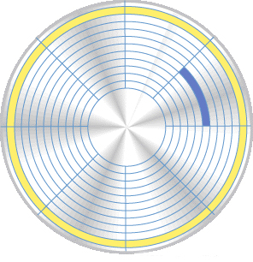
Low Level Formatting
Cluster
Sector
Before you can write data to a disk, you must first low level format the disk. In this process, the drive manufacturer marks the tracks and sectors of the disk.
An OS will perform a high level format to organize the disk into clusters for file storage. A cluster consists of several sectors.
Track

Slide 43
Head Disk Interface
8

Slide 44
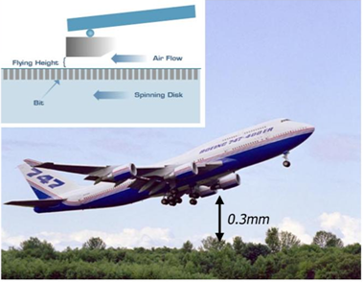
Head Flying Height

Slide 45
Ramp load/unload dynamics
www.hitachiGST.com

Slide 46

What is access time?
Amount of time device takes to locate data
Considerations
access time
cost per megabyte
volatility
capacity
portability
Memory (RAM)
faster
more expensive
SSD
cost
speed
Hard Disk
slower
Compact Disc
less expensive
Tape

Slide 47
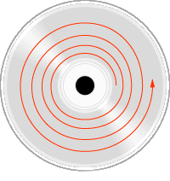
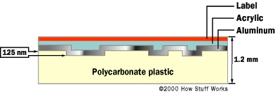
Optical Memory
High capacity
CD – 650 MB
DVD – 4.7 GB ~ 17 GB
Slow access time ~ 100 ms
Slow transfer rate
1X = 150 KB/s
40X = 40 * 150 KB/s = 6 MB/s
Low cost media
Non-Volatile
Removability – Easy to carry
Built in dust protection
Reliability – non-contact operation, no wear/friction

Slide 48
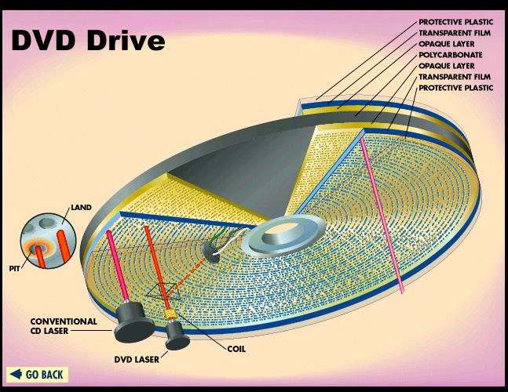
How a DVD Drive Works

Slide 49
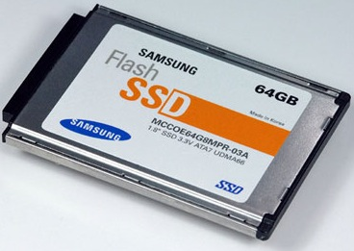
Solid State Memory SSD
Flash drive (EEPROM)
Fast access time
Non-volatile
Small physical size
Easy to carry
Ruggedness and good durability
low power consumption
little heat generation
quiet operation
Many incompatible formats
lack of storage capacity
Expensive but price coming down fast

Slide 50
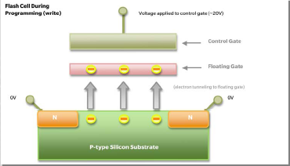
NAND Flash
NAND flash leverages electron tunnelling to store charges onto floating gates
Charge storage creates voltage that is sensed – cell becomes programmed

Slide 51
SLC versus MLC
SLC stores one bit per cell
MLC utilizes multiple voltage states to store two or more bits per cell.
lower cost at higher data density
Reference point
SLC
SLC
Reference point
Notes:
In single-level cell (SLC) NAND flash technology, each cell can exist in one of two states, storing one bit of information per cell. Most MLC NAND flash memory has four possible states per cell, so it can store two bits of information per cell. This reduces the amount of margin separating the states and results in the possibility of more errors. Multi-level cells which are designed for low error rates are sometimes called enterprise MLC (eMLC).

Slide 52
Incursion of SSD in HDD Markets
Enterprise systems and servers
Fewer SSD with high IOPS at low power consumption.
Multiple high capacity but cheaper HDDs is still needed.
Notebooks and Tab
Lower storage capacities favours SSDs.
SSDs are more costly than HDDs,
Fast start up and always on
Notes:
Two HDD market segments are exposed to future SSD incursion
SSDs achieve high IOPS at low power consumption.
High displacement ratio of one SSD to multiple HDDs
Higher capacity, cheaper HDDs will still be needed.
Need lower storage capacities and are therefore a target market for SSDs.
SSDs can cost 10 times more per gigabyte than HDDs,
Convenience in file transfer

Slide 53
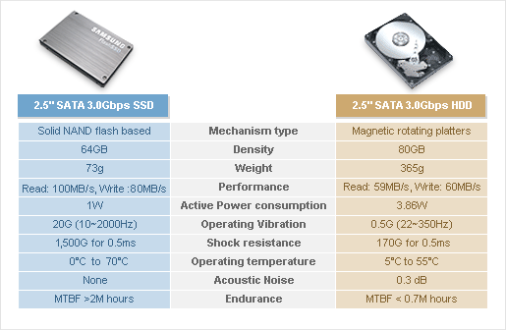
SSD 2.5" vs HDD 2.5"

Slide 54
Activity: Alternative Memory Devices
 | DRAM | HDD | DVD
Speed
Capacity
Price
$/GB
Usage
54

